Slide 1


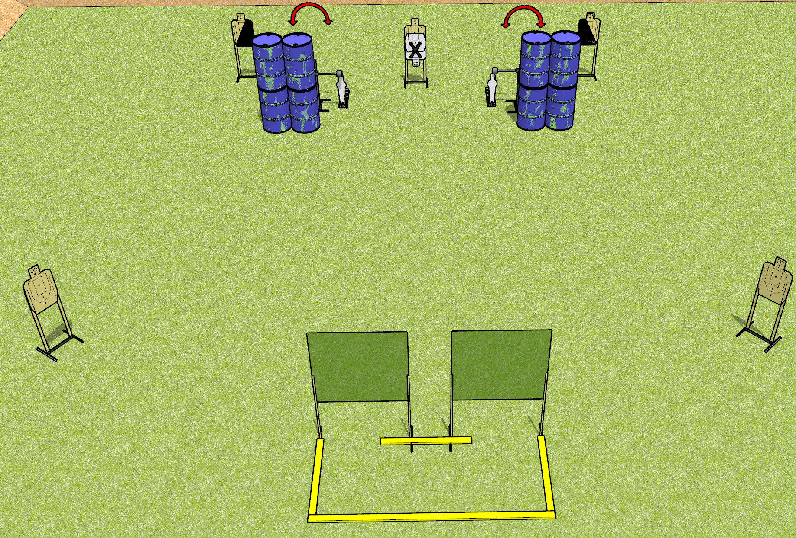
 | Dothan Gun Club – USPSA Match Symmetry Course Designer : Drew Coleman
Round Count 16 rounds 7 USPSA 2 mini poppers
Equipment List 4 wall feet 3 small fault lines 2 swingers 1 left + 1 right diag

Slide 2
Symmetry
Written Stage Briefing
Symmetry is a 16 round, 80 point, Comstock course of fire. There are 7 USPSA targets and 2 steel. The best 2 hits on cardboard will score and steel must fall to score.
Handgun start position is anywhere inside the shooting area, wrists below belt. Handgun is loaded and holstered.
PCC start position is anywhere inside the shooting area, stock on belt. Loaded carbine is held with both hands, safety on.
On the audible start signal, engage targets as they become available from within the shooting area.

